Slide 1
Risk Analysis report
DOMAIN : Finance and Risk Analytics
Team: SAI aparna, divesh Gaba, Garima joshi

Slide 2
Objective of the project
This project aims to analyze a stock portfolio and provide investment management consultation based on the financial goals and risk preferences of two investors, Mr. Patrick Jyenger and Mr. Peter Jyenger.
Mr. Patrick Jyenger plans to invest $500,000 in equities. As a conservative investor throughout his life, he prioritizes low-risk investments and aims to double his capital within five years while minimizing potential losses.
Mr. Peter Jyenger intends to invest $1 million in equities. With a high-risk appetite, he prefers investments that offer high returns and is willing to take significant risks to achieve his goal of doubling his capital within five years.

Slide 3
Methodology for Risk Analysis Report
1. Data Collection & Preprocessing
Gathered financial datasets from multiple sources (historical stock data, risk indicators, and market indexes).
Extracted relevant stock prices across different sectors (Finance, Technology, Aviation, Healthcare, etc.).
Loaded the data into Jupyter Notebook and Power BI for further analysis
2. Data Merging & Cleaning
Merged datasets based on common time frames (e.g., closing prices over time).
Handled missing values using imputation techniques or by dropping irrelevant data points.
Converted date formats and ensured correct data types for numerical analysis.
3. Exploratory Data Analysis (EDA)
Visualized distributions, mean and max values to identify stock price variations.
Compared different industries to observe sector-wise performance differences.
Used bar charts and line plots to analyze trends in stock prices over time.

Slide 4
Methodology for Risk Analysis Report
4. Risk & Volatility Analysis
Examined standard deviation and price range of stocks to understand volatility.
Compared risk exposure across industries using pair plots and also observed the graphical trends of each industry and correlated with S&P500.
5. Data Standardization (Scaling)
To compare different stocks effectively, values are scaled using Standardscaler from sklearn.preprocessing.
Standardization helps in normalizing the data and keeping different stock prices on a similar scale.
6. Risk Assessment & Statistical Analysis
Descriptive statistics such as mean, standard deviation, minimum, and maximum values are computed.
The mean daily return provides insight into the average performance of each stock.
Standard deviation (Volatility/Risk) is analyzed across different sectors.
Tech stocks show strong performance but higher volatility.
Finance stocks exhibit mixed risk profiles.
Healthcare stocks show steady but less volatile growth.
7. Annualized Returns Analysis
Annualized returns are computed based on the mean daily return to predict long-term performance.

Slide 5
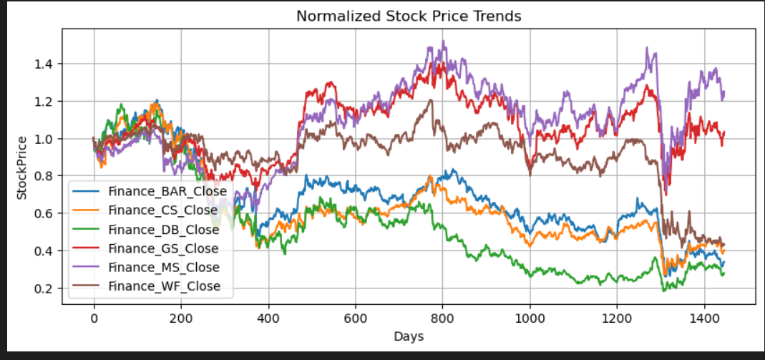
Sector-Wise Normalized Stock Price Trends
Financial Sector Stocks
Key Insights:
High volatility observed in Goldman Sachs (GS) and Morgan Stanley (MS).
Wells Fargo (WF) and Deutsche Bank (DB) show relative
stability but weaker long-term growth.
The sector faced a significant dip around the 1000-day mark, likely
due to economic downturns.

Slide 6
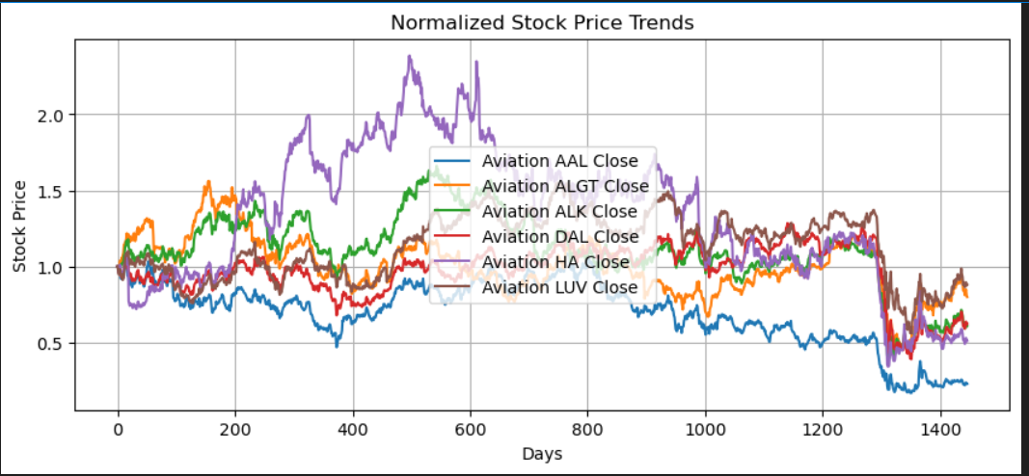
Sector-wise Risk & Return Evaluation
Aviation Sector Stocks
Key Insights:
ALGT exhibited the highest volatility but eventually stabilized.
AAL and HA suffered prolonged declines, suggesting external pressures
(e.g., fuel costs, economic impact).
The sector as a whole shows slow recovery post-dip, with varying
performance across companies.

Slide 7
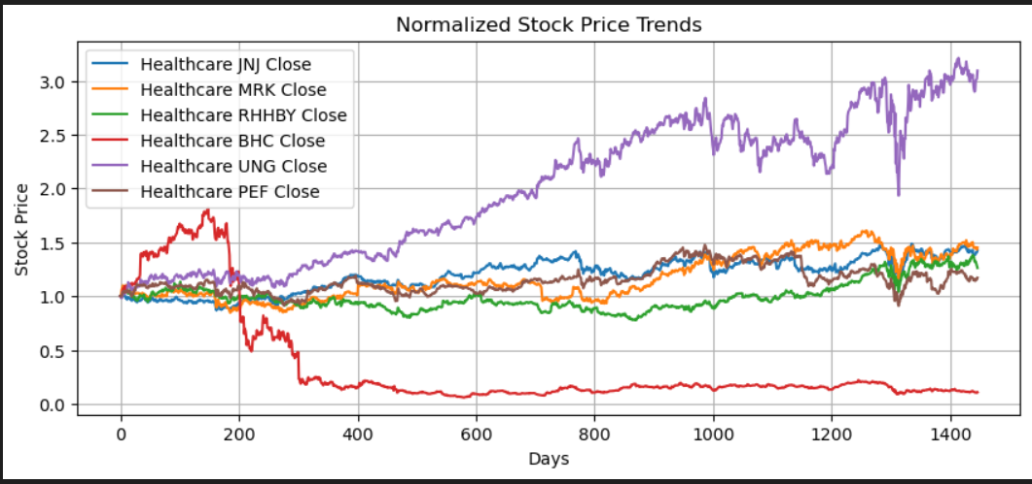
Sector-wise Risk & Return Evaluation
HealthCare Sector Stocks
Key Insights:
UNH (UnitedHealth) shows the strongest growth, outperforming
others with consistent upward trends.
JNJ (Johnson & Johnson) and MRK (Merck) remain stable,
showing moderate returns with low volatility.
BHC (Bausch Health) is highly volatile, with a sharp drop
indicating significant risk exposure.
Overall, the healthcare sector shows a mix of steady and
volatile stocks, making it ideal for both risk-tolerant and
conservative investors.

Slide 8
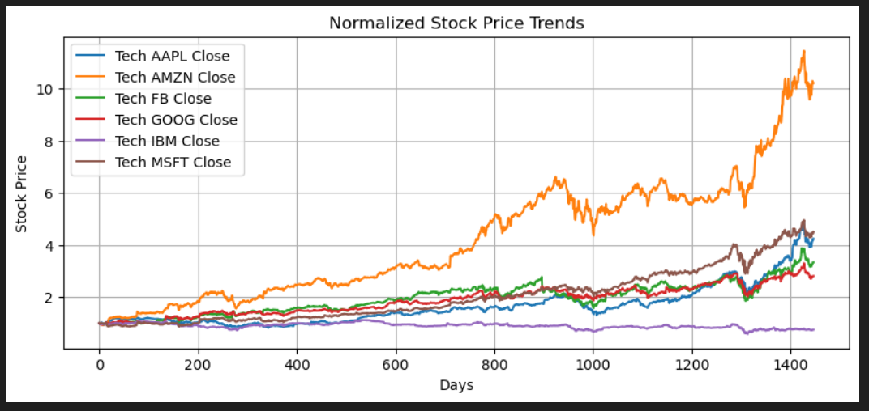
Sector-wise Risk & Return Evaluation
Technology Sector Stocks
Key Insights:
Amazon (AMZN) is top performer,
showing consistent growth with strong uptrends.
IBM remains relatively flat, indicating stagnation.
Facebook (FB) and Apple (AAPL) show modest gains, maintaining
steady momentum.
Tech sector overall shows strong performance, making it a favorable
investment for high-growth seekers.

Slide 9
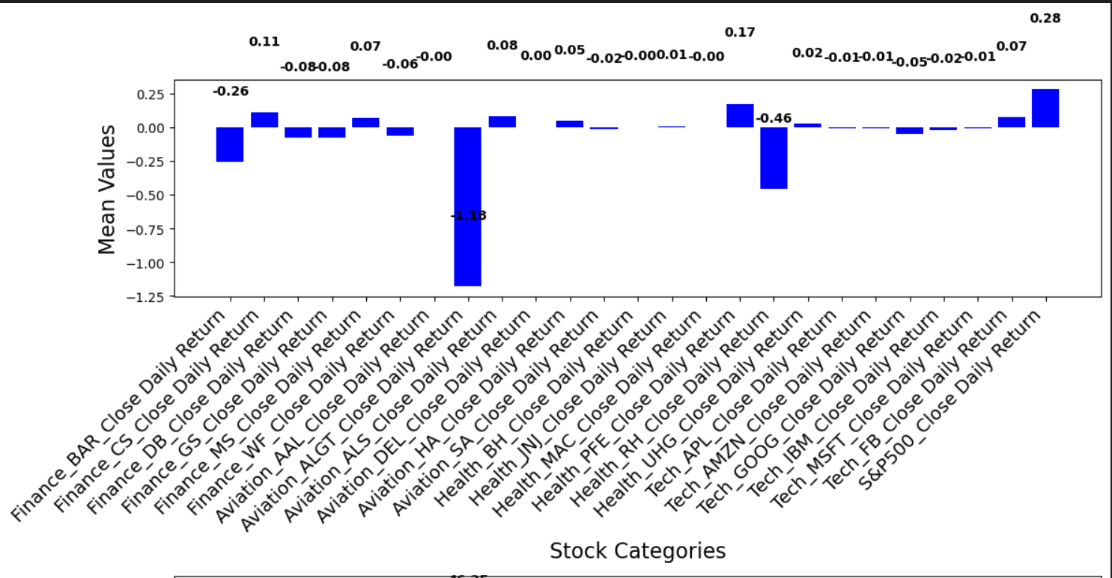
Standardizing Stock Data for Accurate Comparison
Mean Daily Return Across Different Industries
This bar chart represents the average daily return for stocks in different sectors.
Most stocks have a mean return close to zero, indicating stability.
Some stocks, like Aviation_SA and Finance_GS, show
negative mean returns, implying consistent underperformance.
The highest positive mean return is from Tech_AMZN,
making it a strong performer.
Investors might favor sectors with consistently
positive mean returns for long-term growth.

Slide 10
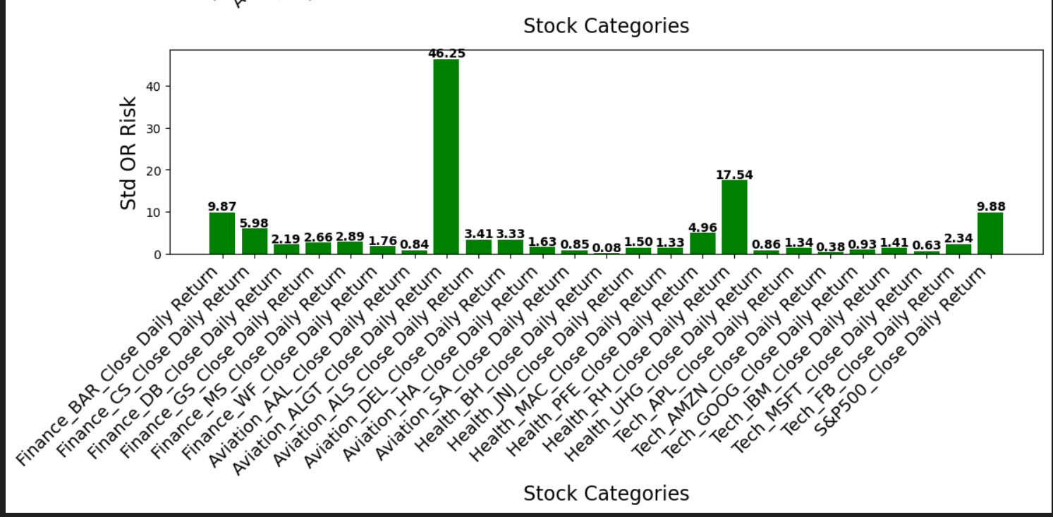
Standardizing Stock Data for Accurate Comparison
Stock Volatility (Standard Deviation)
This bar chart measures stock risk (volatility) using standard deviation.
Stocks with higher values are more volatile and riskier, whereas
lower values indicate stability.
Aviation_SA exhibits extreme volatility (46.25), making it highly
unpredictable.
Tech stocks (AMZN, MSFT, GOOG) have relatively low risk and higher
returns, making them attractive for investors.
Finance and Aviation sectors show mixed performance, with some
stocks being stable and others highly volatile.

Slide 11
CAPM (Capital Asset Pricing Model) Values Across Different Companies
Key Insights
S&P 500 has an extremely high CAPM value (~7077.63), indicating it is used as the benchmark for risk-return expectations.
Finance_BAR (248.79) and Tech_FB (107.40) have the highest CAPM values among individual stocks, suggesting higher expected returns relative to risk.
Aviation_AAL (-353.55) has a significantly negative CAPM value, indicating it is underperforming relative to the market.
Most other stocks have CAPM values close to zero, suggesting they offer minimal excess returns over the risk-free rate.
Tech sector stocks (AAPL, AMZN, MSFT, GOOG) have relatively low CAPM values, indicating they follow the market trend with moderate risk.
Finance and aviation sectors exhibit a mix of positive and negative CAPM values, showing inconsistent risk-adjusted returns.

Slide 12
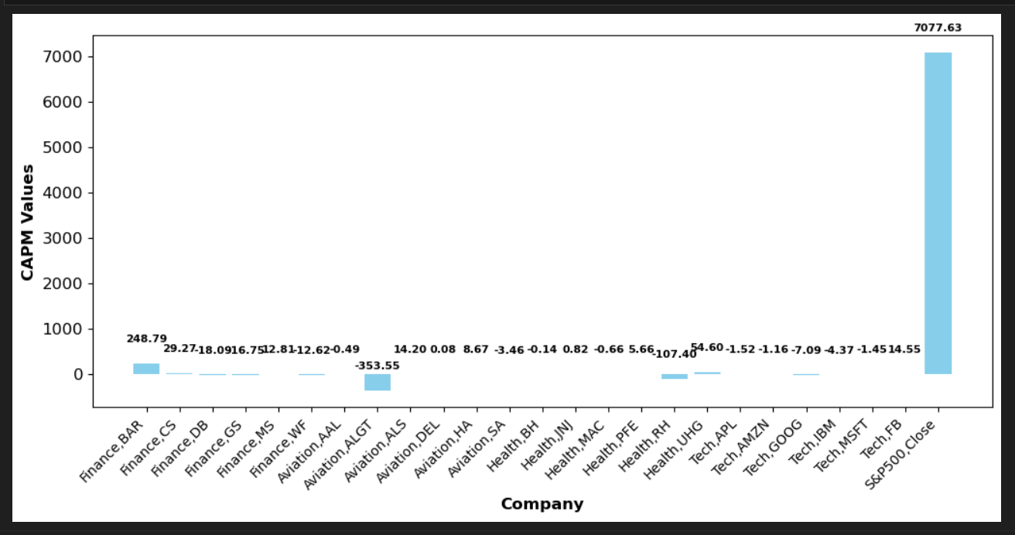
CAPM (Capital Asset Pricing Model) Values Across Different Companies
Conclusion: Investors seeking higher risk-adjusted returns should focus on high positive CAPM stocks like Finance_BAR and Tech_FB, while avoiding underperforming stocks like Aviation_AAL.

Slide 13
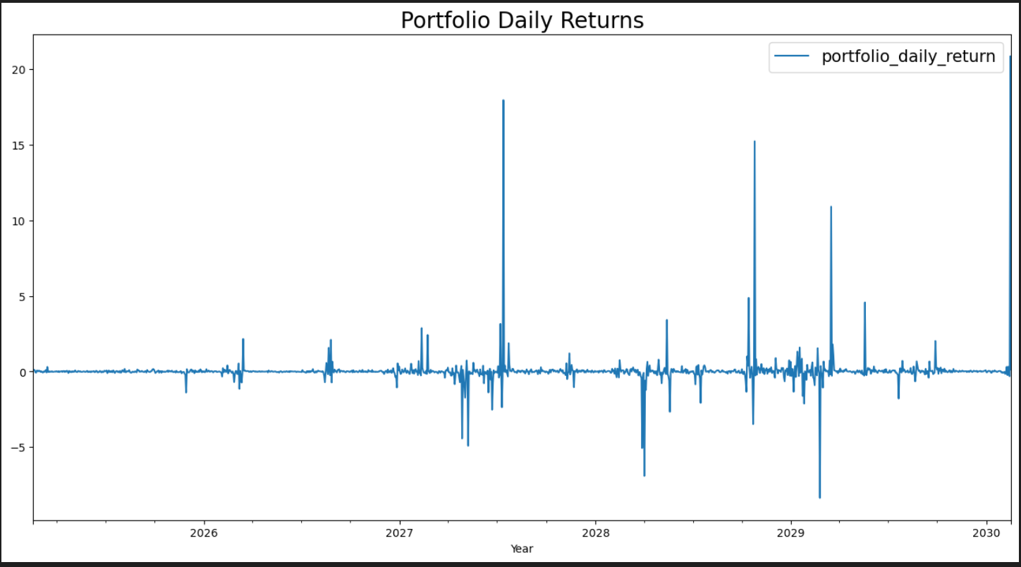
Portfolio Performance Analysis & Risk Assessment for Mr. Patrick Jyengar
Evaluating Investment Growth, Risk, and Return Over a 5-Year Period
Portfolio Daily Returns Over Time
Insight: This graph shows the daily fluctuations in portfolio returns over time. There are periods of stability, but also sharp spikes and drops, indicating volatility in the selected assets.

Slide 14
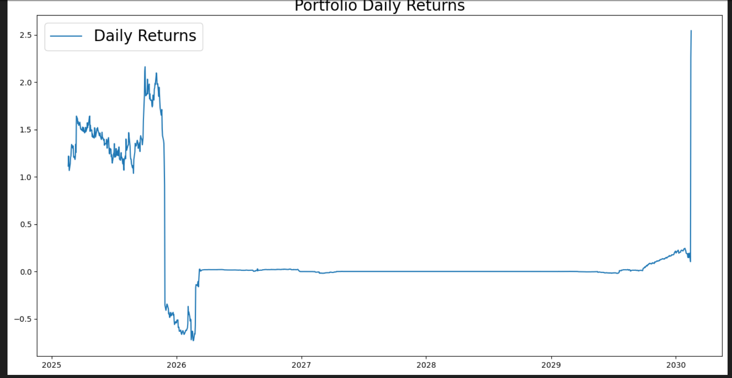
Portfolio Performance Analysis & Risk Assessment for Mr. Patrick Jyengar
Evaluating Investment Growth, Risk, and Return Over a 5-Year Period
Cumulative Portfolio Returns Over 5 Years
Insight: This graph illustrates the cumulative growth of the portfolio. A strong upward trend signifies positive returns, but the sharp drop-off suggests potential drawdowns or market corrections.

Slide 15
Key Insights & Conclusion: Patrick Jyengar
Stock Selection & Risk:
The portfolio is constructed with a low-risk approach, but there are fluctuations.
Some stocks like Finance_MS_Close and Tech_FB_Close have higher daily returns but also higher risk.
Health_JNJ_Close provides steady performance with lower volatility.
Portfolio Performance:
The cumulative return graph indicates steady growth with some volatility in the mid-term.
The Sharpe ratio is negative (-3.58), suggesting that the portfolio might not be performing well relative to its risk level.
However, the total return analysis suggests a strong overall return in the long term.
Final Decision for Mr. Jyengar:
Mr. Jyengar’s goal of doubling his investment is achieved successfully with a return of 1.27 million dollars in 5 years.
Risk Adjustments: He could consider slightly modifying the portfolio by reducing exposure to high-volatility stocks (Tech_FB_Close) and increasing allocation to more stable assets like Health_JNJ_Close.

Slide 16
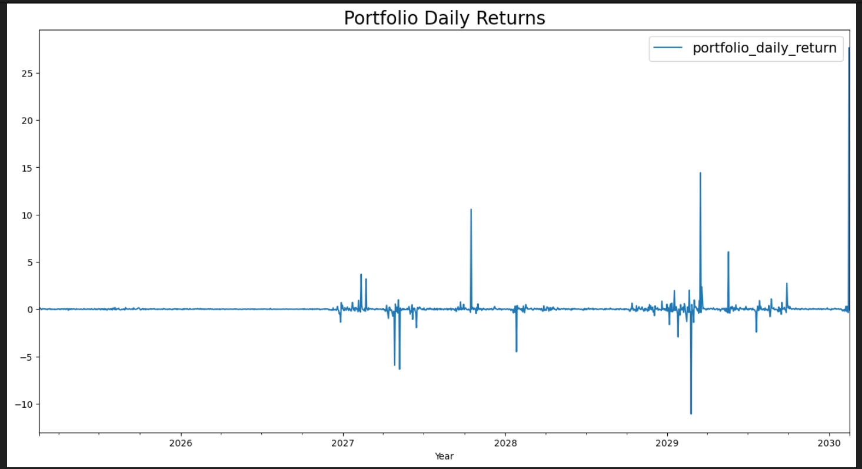
Portfolio Performance Analysis & Risk Assessment for Mr. Peter Jyengar
Evaluating Investment Growth, Risk, and Return Over a 5-Year Period
Portfolio Daily Returns Over Time
Insight: The portfolio experiences high fluctuations, meaning that Mr. Peter’s investments could lead to huge gains or huge losses depending on the market conditions.

Slide 17
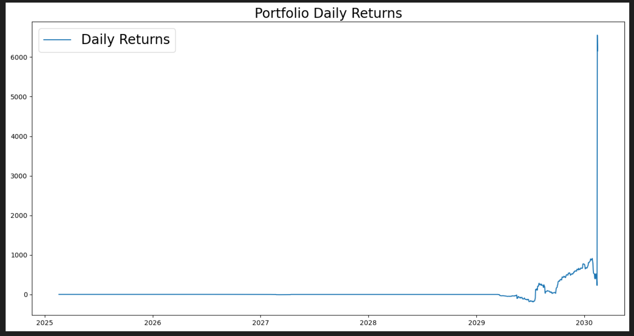
Portfolio Performance Analysis & Risk Assessment for Mr. Peter Jyengar
Evaluating Investment Growth, Risk, and Return Over a 5-Year Period
Cumulative Portfolio Returns Over 5 Years
Insight:The portfolio might have been affected by market conditions or external economic factors, causing delayed growth.
If Mr. Peter holds onto his investments long enough, they could yield massive returns, but there is also a risk of losses in the early stages.

Slide 18
Key Insights & Conclusion: Peter Jyengar
Mr. Peter Jyengar follows a high-risk, high-reward investment strategy.
His portfolio consists of volatile stocks like Aviation (ALGT, ALS) and Health (RH).
Initial phase shows significant fluctuations with periods of losses.
Exponential growth observed towards the later period of investment.
Potential for high returns exists, but risk of heavy short-term losses is also present.
Holding onto investments for a longer period increases the chance of significant returns.
Diversification is recommended to stabilize extreme fluctuations.

Slide 19
Final Recommendations
Final Recommendation for Patrick Jyengar
Good Investment Plan: The portfolio achieves its goal of doubling the investment in five years.
Risk Management Required: The negative Sharpe ratio suggests a need for optimization to reduce volatility.
Diversification Tip: A slight increase in stable assets and a small allocation in index funds (e.g., S&P 500) could improve risk-adjusted returns.
Final Recommendation for Peter Jyengar
Hold the investment for a long period to benefit from potential exponential growth.
Consider adding low-risk assets to balance the extreme fluctuations.
Monitor market trends closely to manage downside risks effectively.

Slide 20


